Slide 1
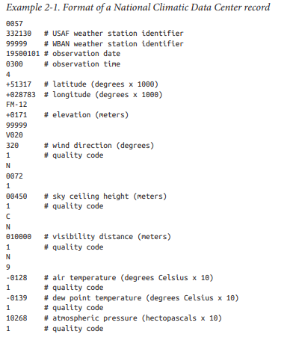
Weather Dataset
Air Temperature and Quality code are required variables to find Max Temperature.

Slide 2
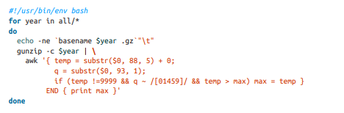
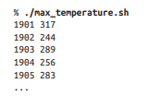
Analyzing data with Unix Tool
Interpreted Programming Language
Code Output

Slide 3
Analyzing data with Unix Tool
We are having years of data and we must process it.
We will select only required variables and perform a test to see temp is valid or not.
9999 – represents Missing Values
After reading the data, temp will be compared to max seen value so far.
At the end we execute maximum temperature.
To process 1 Century Data – 42 minutes -1 single EC2
If we run the program in parallel it may take less time but we have problems.

Slide 4
Analyzing data with Unix Tool
Dividing the work in-to equal sizes is not easy and file size for every year changes.
Larger file will take more time to execute, so we split the data in-to fixed size chunks & assign each chunk to a process.
After processing we will be combining the results from independent processes and again we need to process to get final output.
Still, it will take 20 minutes and we can’t go beyond and some-times it becomes messy too.

Slide 5
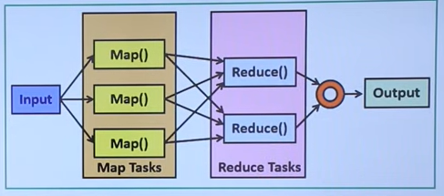
Analyzing Data with Hadoop
Map Reduce

Slide 6
Analyzing Data with Hadoop
Input – NCDC Data
Map Function – Data Preparation
Reduce Function – Finding Max. Temperature

